Slide 1
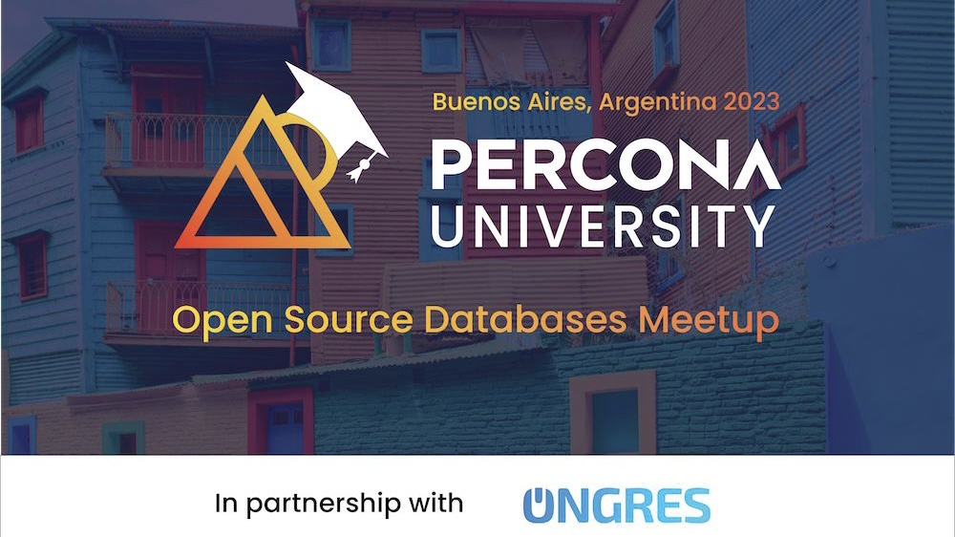

Slide 2
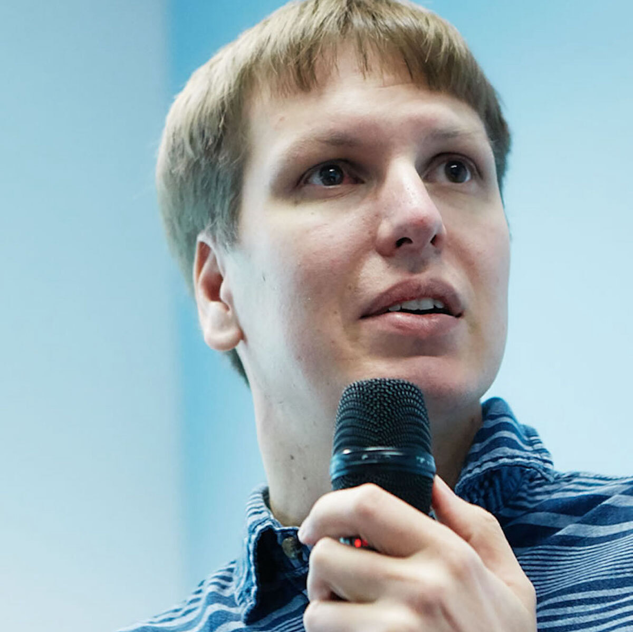
Welcome
Peter Zaitsev,
Founder at Percona
20 October 2023

Slide 3


Slide 4


Thank you to our Sponsors and Partners
Notes:
OnGres and Álvaro Hernández (Founder & CEO) – Sponsor
Eduardo Casarero (Percona) Thank you for help with venue and resolving lots of issues at local level

Slide 5

Michael Ritossa your friendly
Percona Sales Person
michael.ritossa@percona.com
Cell 6572505630

Slide 6


We are Hiring!
Become a
Percona Superhero!
Contact
careers@percona.com
https://www.percona.com/about/careers

Slide 7

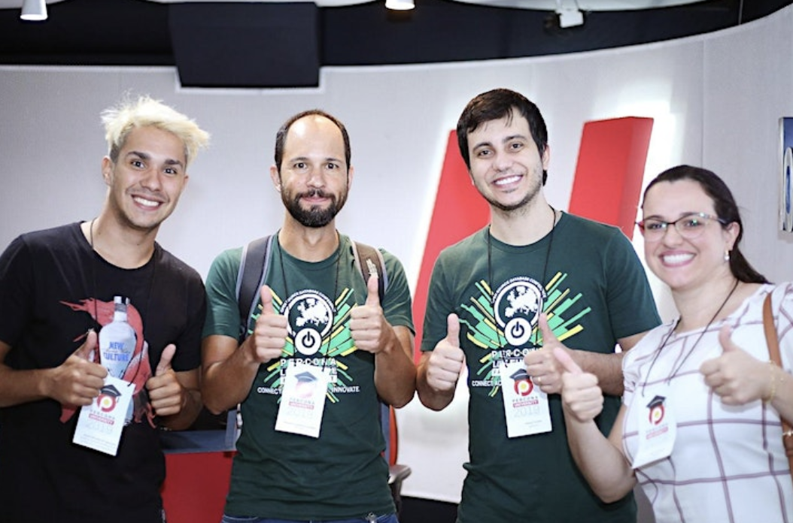
Bring Percona University to Your City!

Slide 8
Cloud of Freedom
or
Cloud of Serfdom ?

Slide 9
My Prospective
Involved in Open Source since late 1990s
Early Staff member of MySQL AB
Founder, until recently CEO at Percona
Investor, Advisor, Mentor in Open Source Businesses
Open Source Advocate

Slide 10

Better
Everything being Equal Open Source is a better choice

Slide 11

Investment
It is smarter to invest in your resources in making Open Source better rather than paying for Proprietary Software

Slide 12
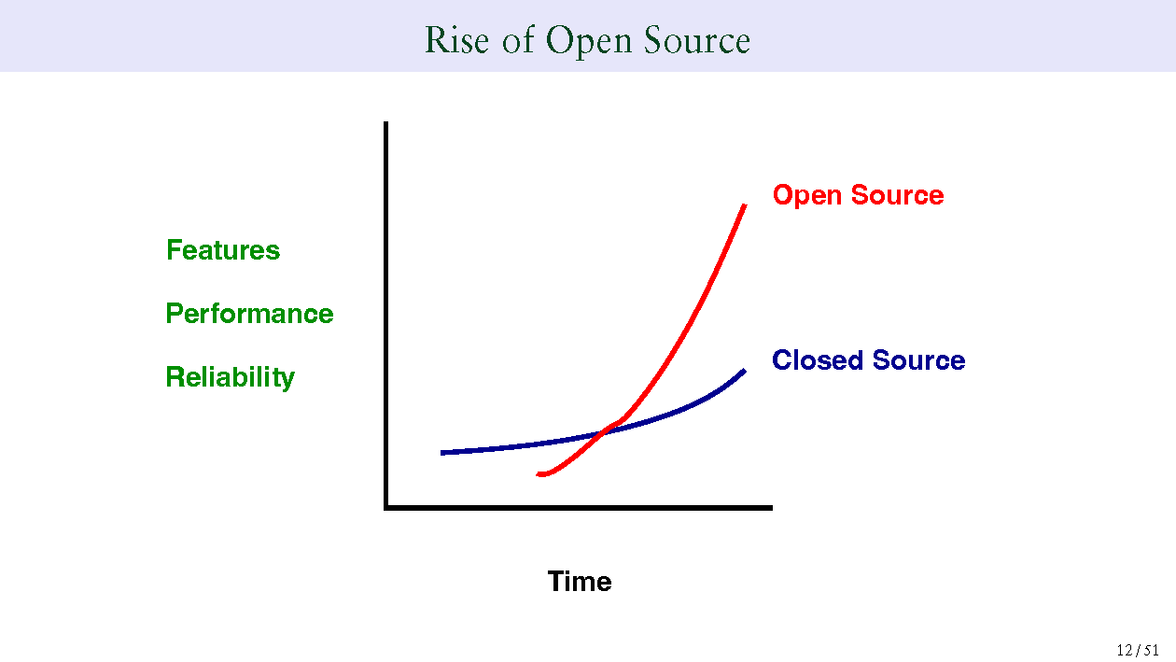
Open Source and Proprietary
https://momjian.us/main/writings/pgsql/forever.pdf

Slide 13


Have we been here before ?

Slide 14

Open Source in the Cloud
But do not Cloud Vendors just make Open Source Easier ?

Slide 15

Old Strategy
“Embrace, extend, and extinguish”

Slide 16

Usability and Ease of use
New Frontier for the competition

Slide 17

Cloud only Skills
Increasingly “Open Source Experts” have only Managed Cloud Solutions Skills

Slide 18
Cloud Vendor Push
Using their Proprietary or Managed solutions as Best Practice
1
Increasing Price Difference for such Managed Solutions
2
Embracing Scaling by Credit Card
3

Slide 19
Venture Funded Open Source
Often Abandon Open Source Licenses to Create Monopoly Protect themselves from Unfair Competition from the Cloud.

Slide 20

Community Open Source
Largely Embraces adoption by Cloud Vendors as it increases user base

Slide 21
Growth at any Cost
Focus on last decade was growth at any cost
Pushing as much on third parties (Cloud Vendors) makes sense
No resource to put on Open Source requiring “elbow grease”

Slide 22

Subsidized Cloud
First does of Heroin is Free

Slide 23
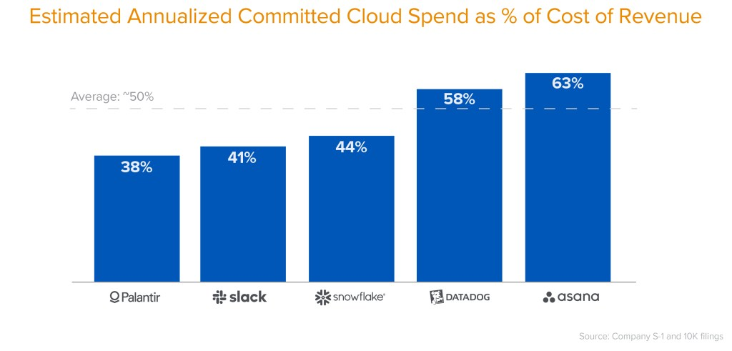
Things are Changing
https://a16z.com/2021/05/27/cost-of-cloud-paradox-market-cap-cloud-lifecycle-scale-growth-repatriation-optimization/

Slide 24
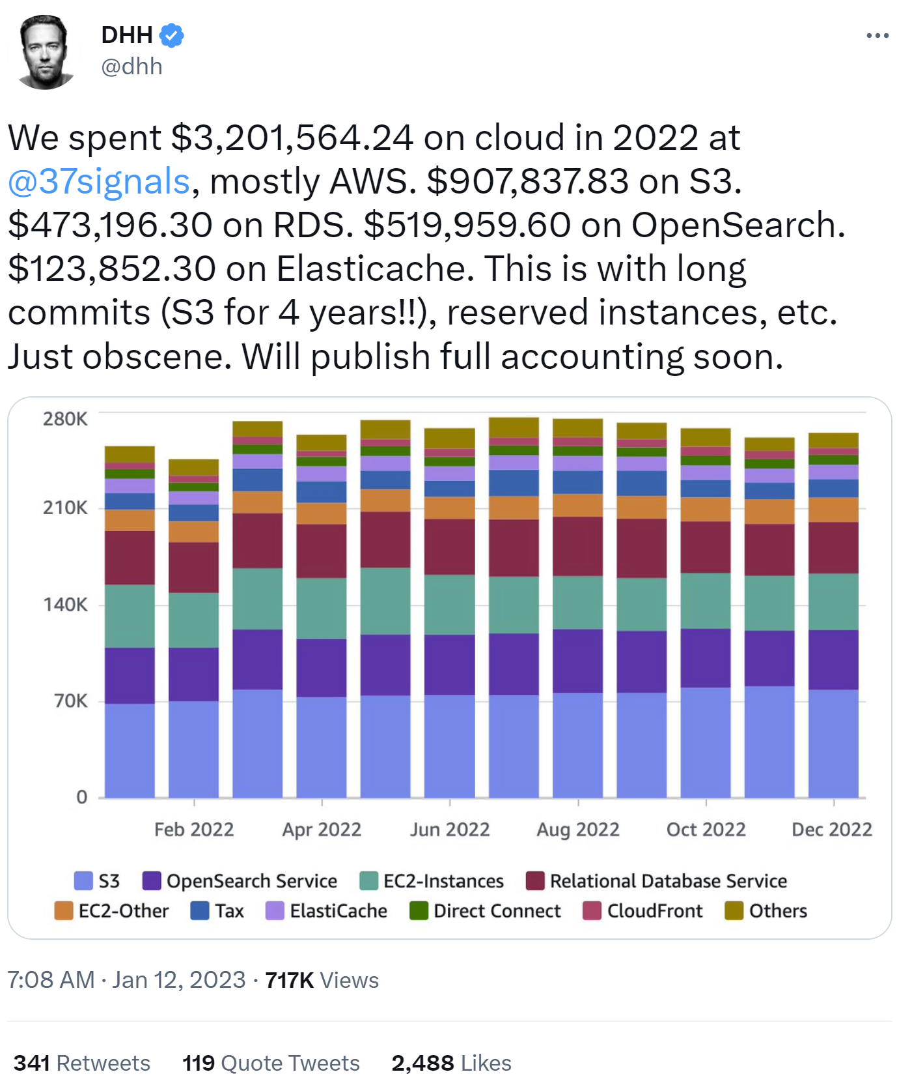
37Signals leaving the cloud
https://twitter.com/dhh/status/1613508201953038337

Slide 25
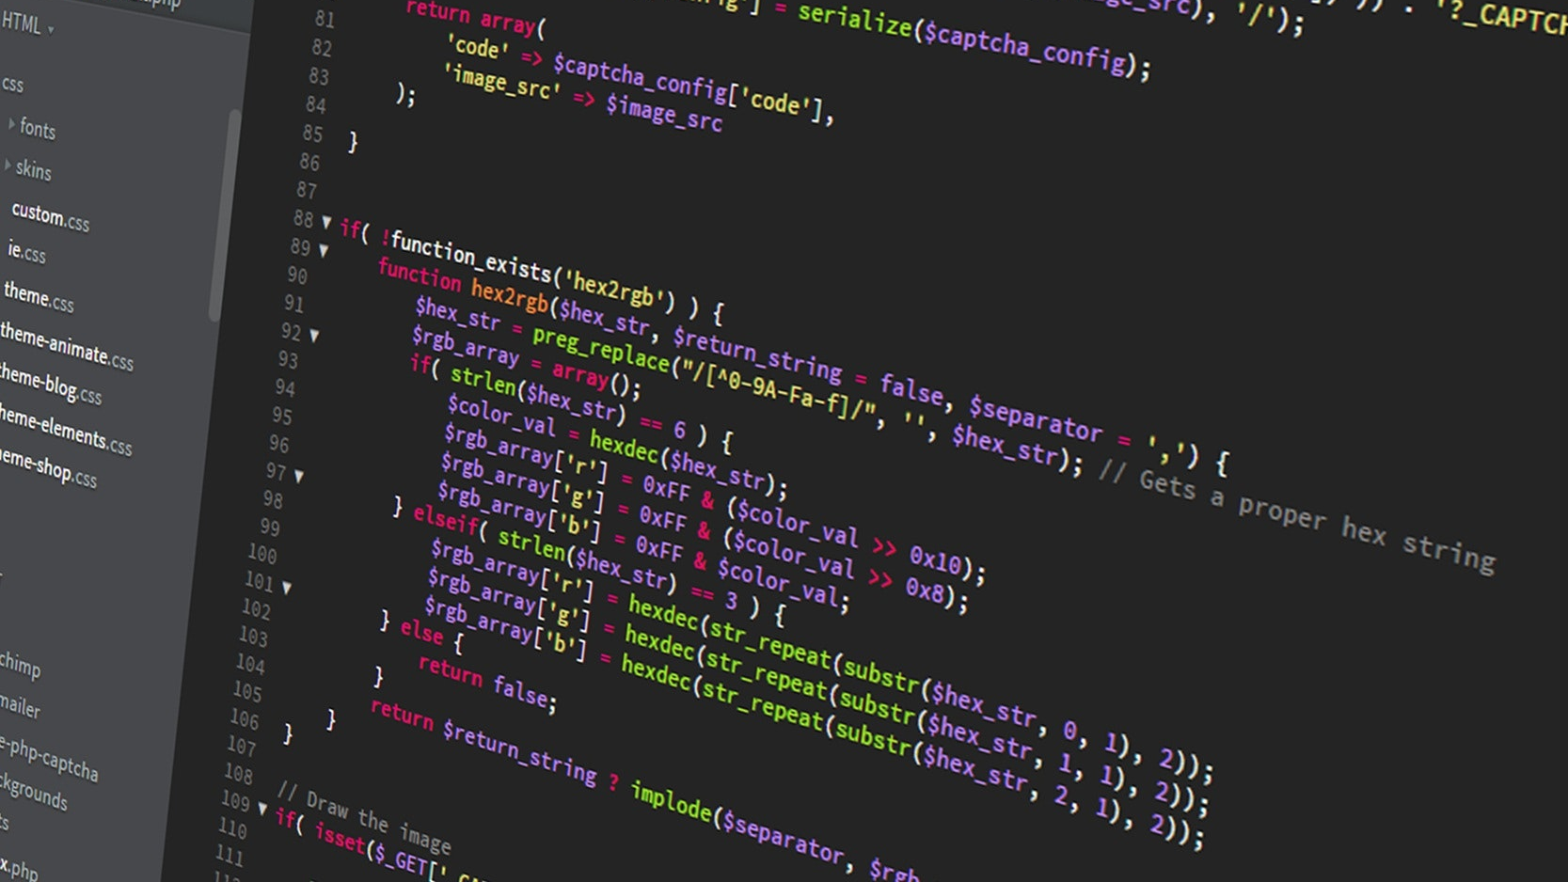
GitOps
Declarative Versioned Infrastractura as a Code

Slide 26
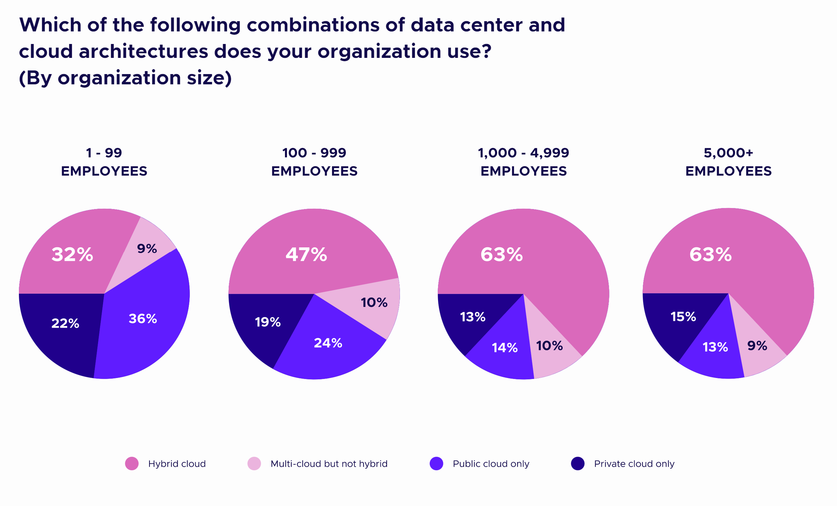
Hybrid Cloud
https://www.cncf.io/reports/cncf-annual-survey-2022/

Slide 27



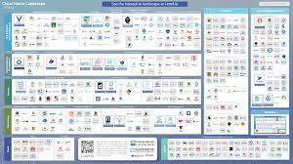
Open Source Catches Up Again
Lock-in with Cloud Vendor
Use Proprietary Solutions
Highly Differentiated Cloud
Hostage
No Vendor Choice
Freedom to Run Anywhere
Use Open Source
Cloud Is Commodity
Customer
Choice of Vendors

Slide 28
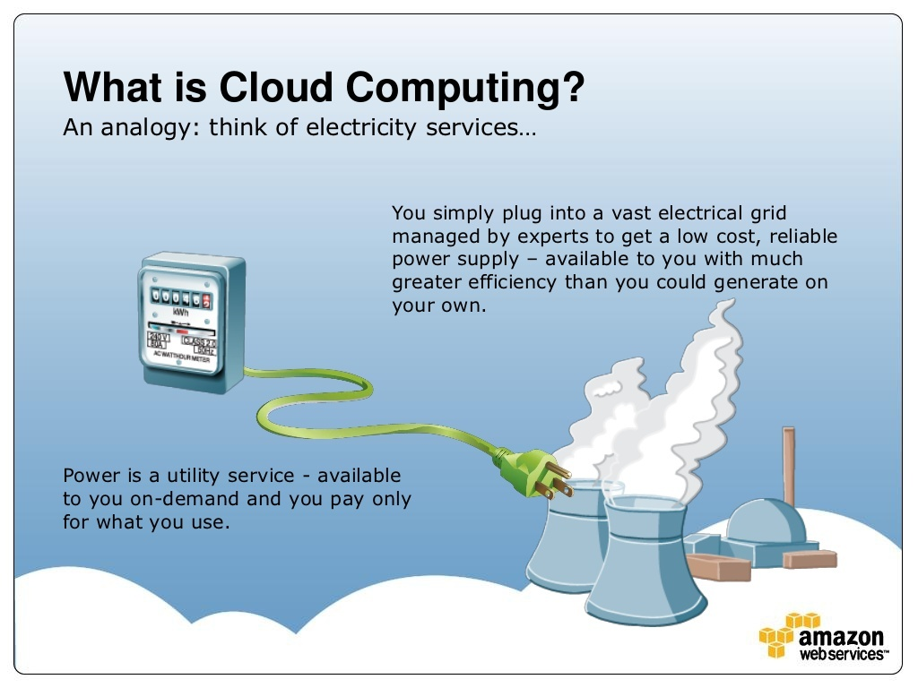
Giving Cloud Its Originally Intended Role of Commodity Infrastructure

Slide 29

Smart API - Kubernetes

Slide 30

DOK Community
https://dok.community/

Slide 31
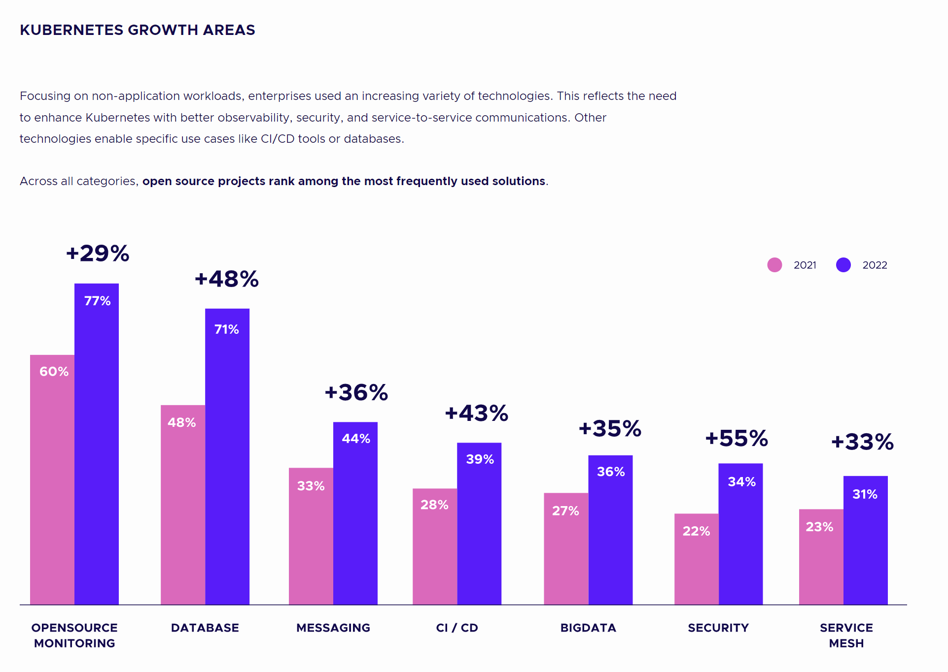
Adoption Areas
https://www.cncf.io/reports/cncf-annual-survey-2022/

Slide 32








Kubernetes Powers many DBaaS

Slide 33

Databases

Slide 34

Data Has Gravity
Hard to Move
Attracts/Pulls other Applications
Creates More Severe Vendor Lock-In
Should be your focus in Achieving your Freedom

Slide 35



Mission Critical Open Source Base Database Software

Slide 36

“Operators” to run them on Kubernetes

Slide 37

Observability and Simplified Management

Slide 38

Percona Everest – Open Source DBaaS Powered by Kubernetes
https://docs.percona.com/everest/

Slide 39
Expertise you can count on
Support
Consulting
Managed Services

Slide 40
Call For Action
Embrace Open Source in the Cloud
Invest in Making it Better
Spread the World
Run Percona 🫡

Slide 41
Thank you, Let’s Connect!
https://www.linkedin.com/in/peterzaitsev/
https://twitter.com/PeterZaitsev
http://www.peterzaitsev.com

